Slide 1









































TITANIUM SPONSORS
Platinum Sponsors
Gold Sponsors

Slide 2

#kcdc2017 @kc_dc @AddThis @jgrodel
Little Mistakes That Cost Big
Lessons Learned in Providing Open Source Software
Slides: https://goo.gl/5Peu5T

Slide 3
TITANIUM SPONSORS
Platinum Sponsors
Gold Sponsors

Slide 4
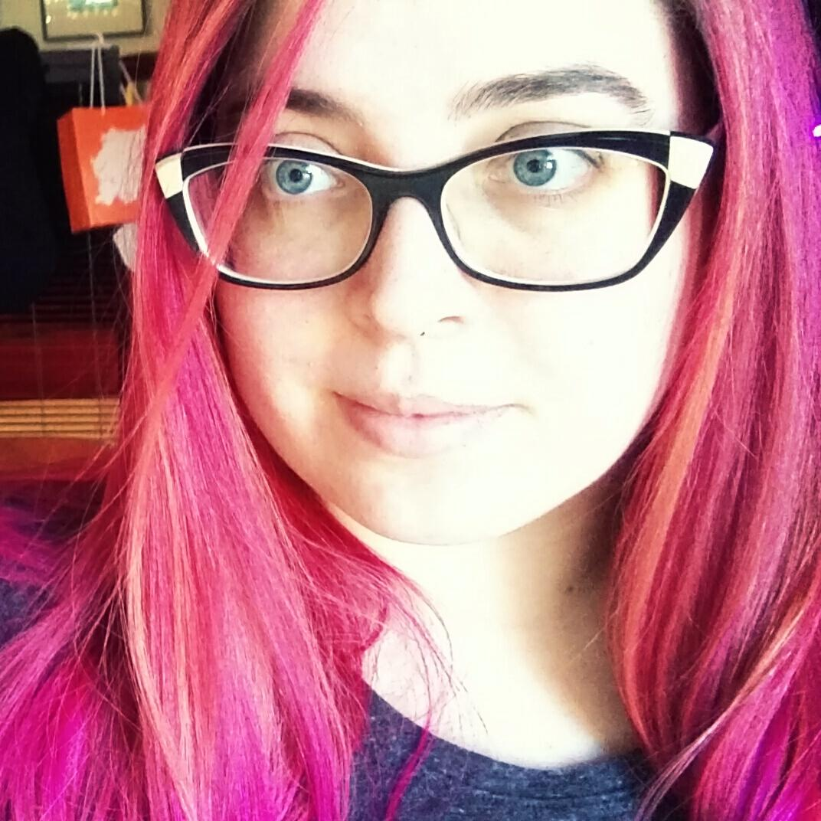

Speaker
Julka Grodel
@jgrodel
AddThis Senior Software Engineer
Notes:
Meetups - Big Data DC, DC Postgres User Group; Social - That Car Podcast

Slide 5
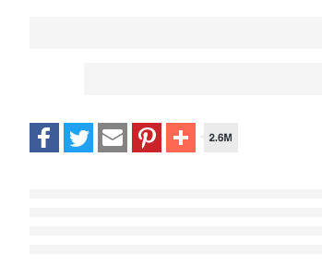
#kcdc2017 @kc_dc @AddThis @jgrodel

Slide 6
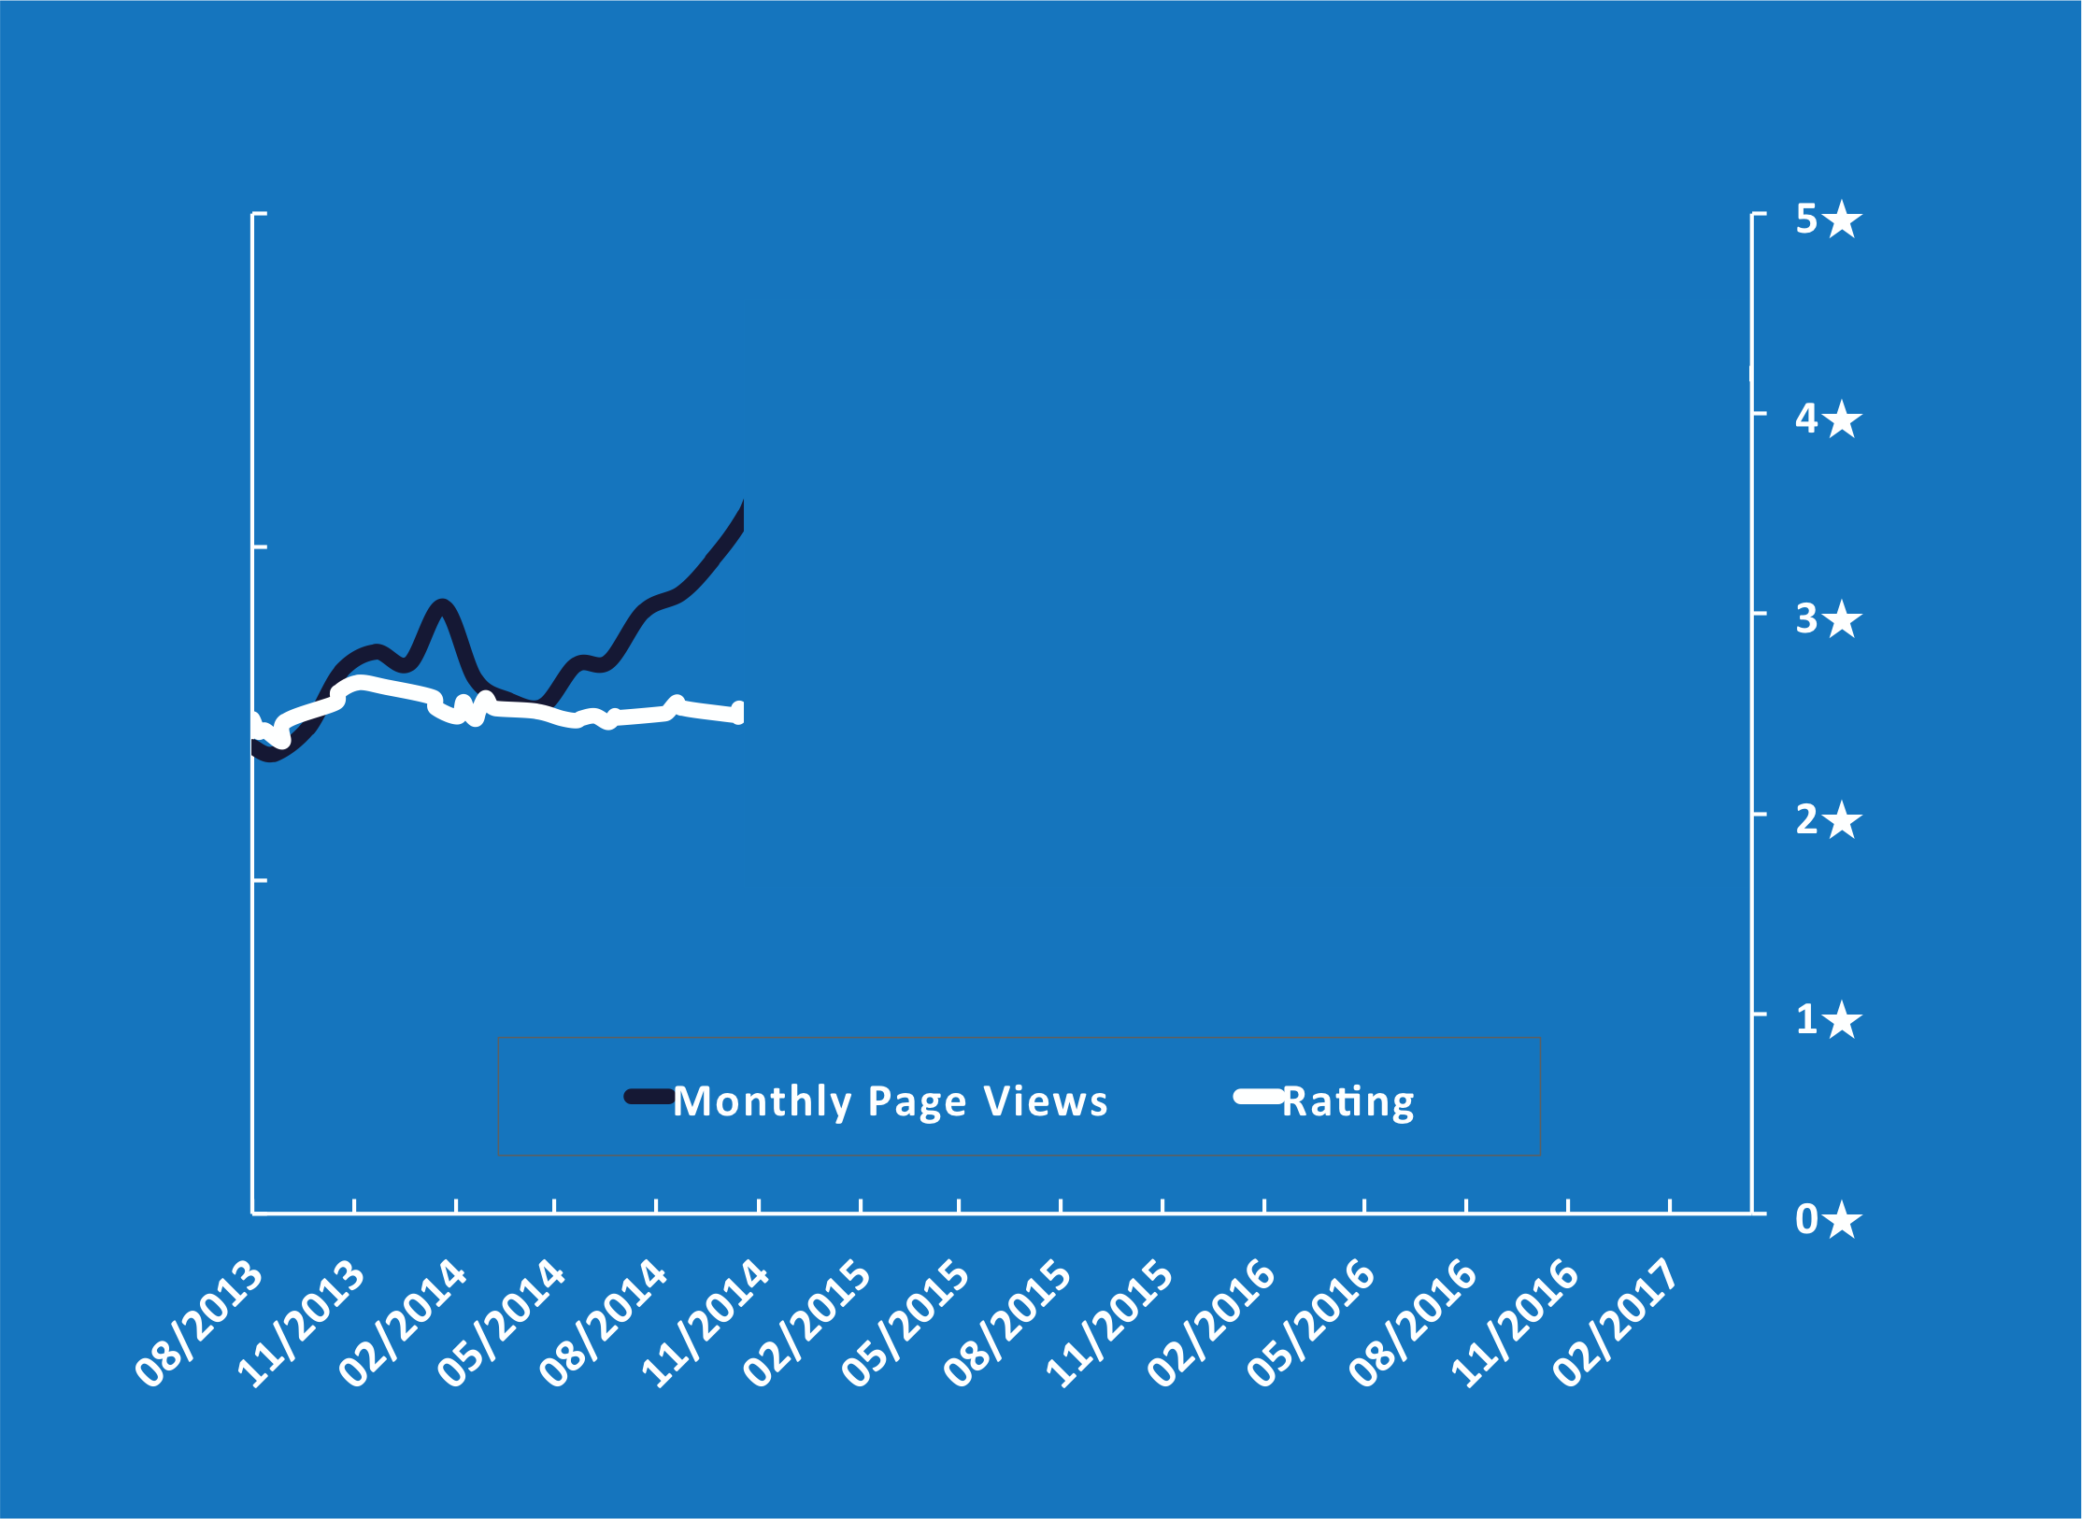
#kcdc2017 @kc_dc @AddThis @jgrodel

Slide 7
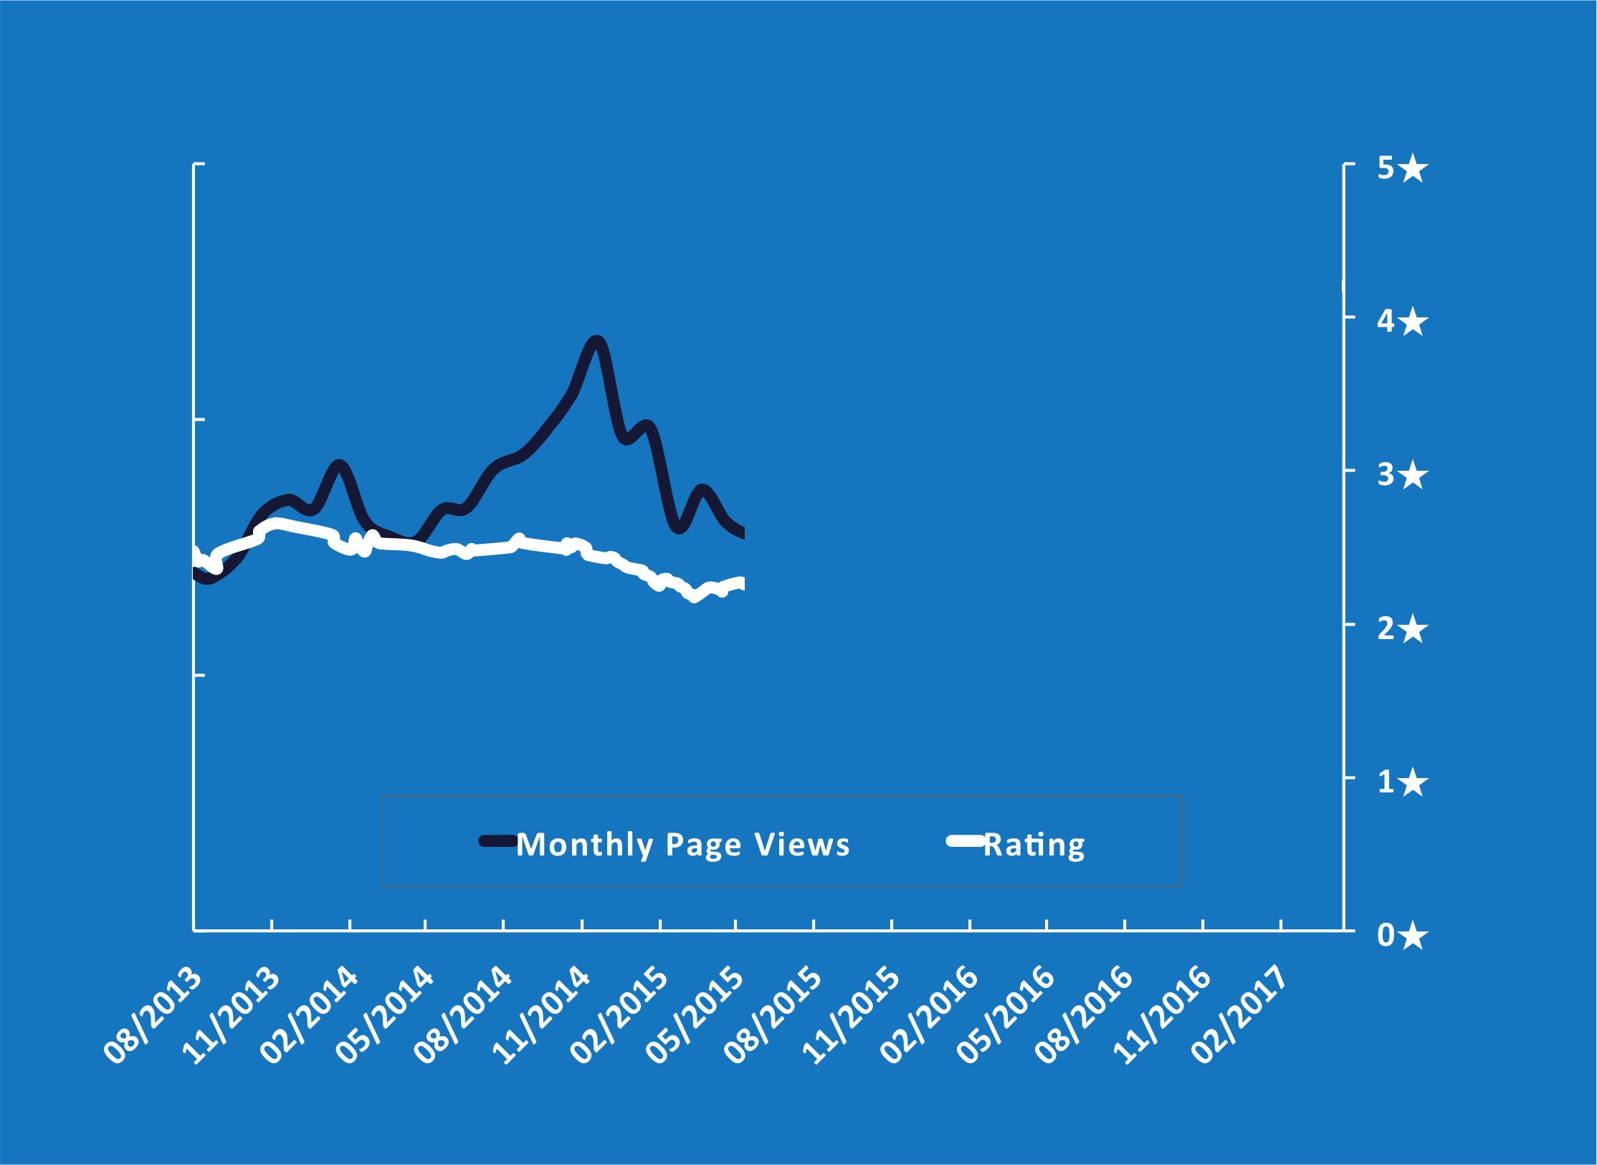
#kcdc2017 @kc_dc @AddThis @jgrodel

Slide 8
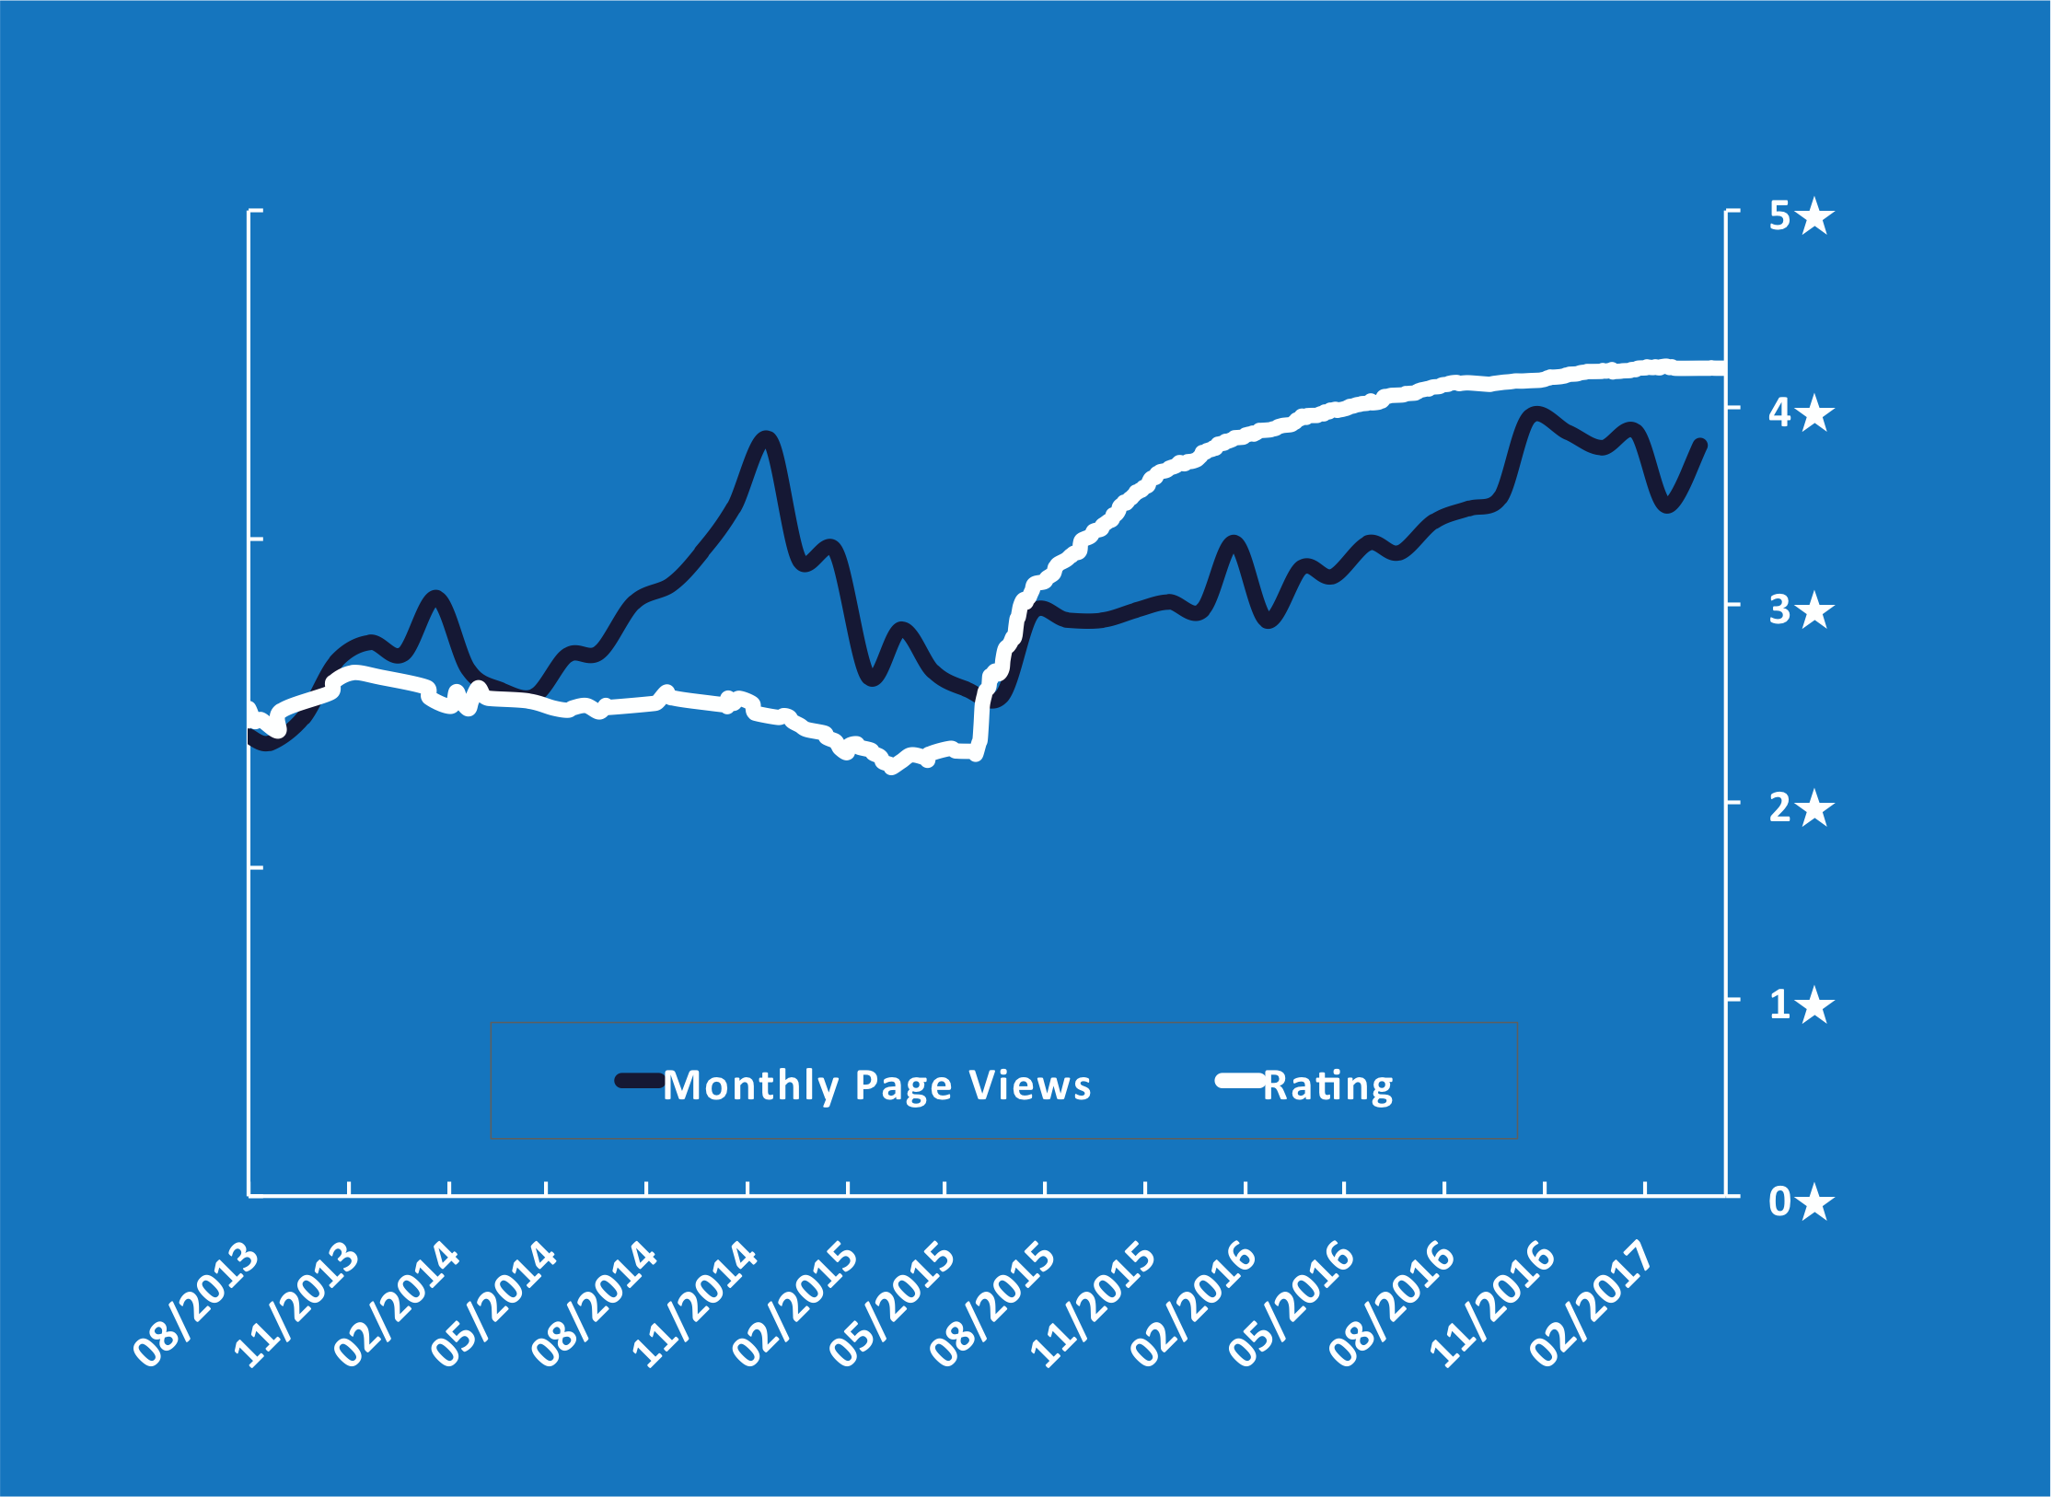
#kcdc2017 @kc_dc @AddThis @jgrodel

Slide 9
#kcdc2017 @kc_dc @AddThis @jgrodel
Managing Community Expectations

Slide 10
#kcdc2017 @kc_dc @AddThis @jgrodel
Website Tools by AddThis
Same idea
Edit all tools on AddThis.com
different results

Slide 11

#kcdc2017 @kc_dc @AddThis @jgrodel
4.6

Slide 12
#kcdc2017 @kc_dc @AddThis @jgrodel
Takeaways
Avoid changing the output
Avoid taking a feature away from an existing user if they’re using it
Document and communicate

Slide 13
#kcdc2017 @kc_dc @AddThis @jgrodel
Semantic Version Numbers
1.0.1 Bug fixes only
1.1.0 New features
2.0.0 Breaking changes

Slide 14
#kcdc2017 @kc_dc @AddThis @jgrodel
Document

Slide 15
#kcdc2017 @kc_dc @AddThis @jgrodel
Oh No You Didn’t

Slide 16
Oh No You Didn’t
if ($password = get_option('addthis_password'))
$addthis_new_options['password'] = $password;
...
// save settings
add_option('addthis_settings', $addthis_new_options);

Slide 17
Oh No You Didn’t
if ($password = get_option('addthis_password'))
$addthis_new_options['password'] = $password;
...
// save settings
add_option('addthis_settings', $addthis_new_options);

Slide 18
Oh No You Didn’t
$url = $endpoint .
'&username='.$username .
'&password='.$password;
$result = wp_remote_get($url);

Slide 19
Oh No You Didn’t
$url = $endpoint .
'&username='.$username .
'&password='.$password;
$result = wp_remote_get($url);

Slide 20
Oh No You Didn’t
function _choose_icons($options) {
extract($options);
if ($name == 'above') {
$option = $above;
...
}
}

Slide 21
Oh No You Didn’t
function _choose_icons($options) {
extract($options);
if ($name == 'above') {
$option = $above;
...
}
}

Slide 22
Oh No You Didn’t
function _choose_icons($options) {
extract($options);
if ($name == 'above') {
$option = $above;
...
}
}

Slide 23
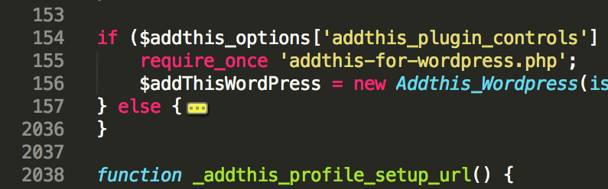
#kcdc2017 @kc_dc @AddThis @jgrodel

Slide 24
#kcdc2017 @kc_dc @AddThis @jgrodel
Leave the Campground Cleaner than You Found It

Slide 25
#kcdc2017 @kc_dc @AddThis @jgrodel
Bad Reviews
Respond
Be kind
Empathize
Assume positive intent
Treat like a support ticket
It’s not always about you

Slide 26
#kcdc2017 @kc_dc @AddThis @jgrodel
Conclusion
https://goo.gl/FnAFHC

Slide 27
#kcdc2017 @kc_dc @AddThis @jgrodel
Thank you!

Slide 28
#kcdc2017 @kc_dc @AddThis @jgrodel
Questions?

Slide 29
TITANIUM SPONSORS
Platinum Sponsors
Gold Sponsors

